Slide 1
Temporary Traffic Control Reference Guide

Slide 2
Useful Information
MUTCD
Link to manual
2009 Edition with Revisions No. 1 and 2 Incorporated, dated May 2012 (PDF) - FHWA MUTCD (dot.gov)
Standard Highway Signs and Markings https://mutcd.fhwa.dot.gov/SHSe/shs_2004_2012_sup.pdf
Temporary Traffic Control is in Chapter 6

Slide 3
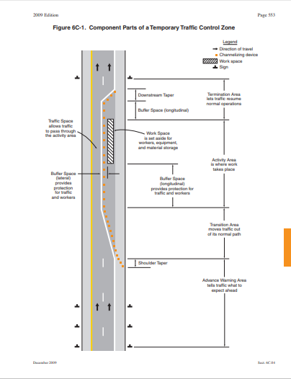

Slide 5
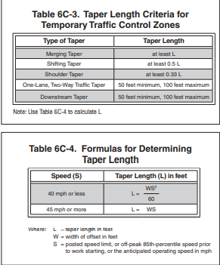

Slide 6
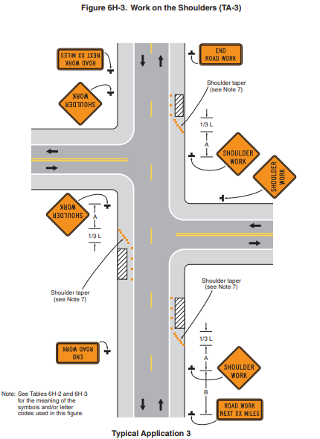

Slide 7
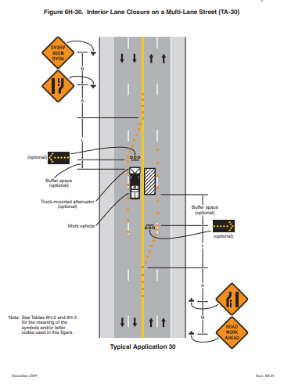

Slide 8
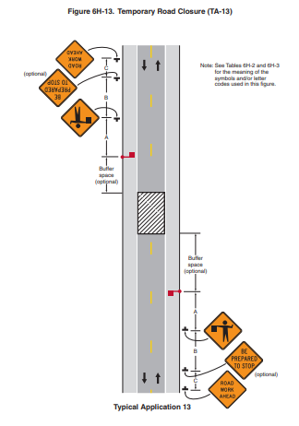

Slide 9
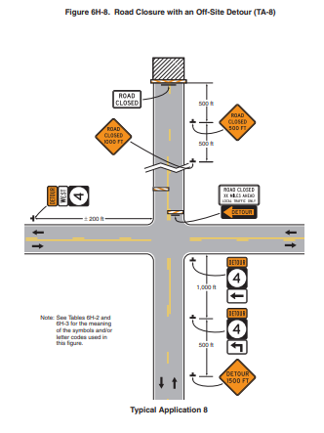

Slide 10
